Slide 1
Identifying Personal Attacks in Wikipedia Comments
By: Samuel Ghebreyesus
Course: CS 5100 (Foundations of Artificial Intelligence)
4/19/2022

Slide 2
Visualizations

Slide 3
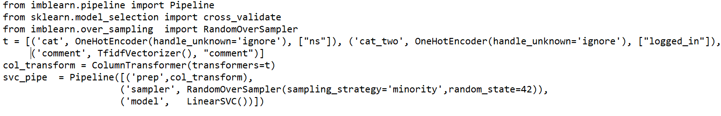
Text Cleaning + Feature Selection + Attack Information
Removed words within parentheses, lowercased words, removed punctuation, removed apostrophes, removed stop words
Final model I chose was the LinearSVC and the only features it took in were ns and logged_in along with comment
Classified comments as attack if mean of attack values greater than 0.5

Slide 4
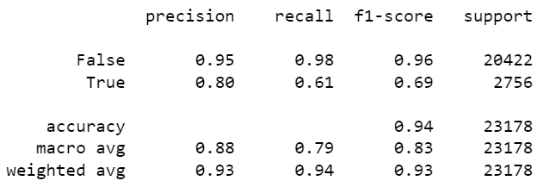
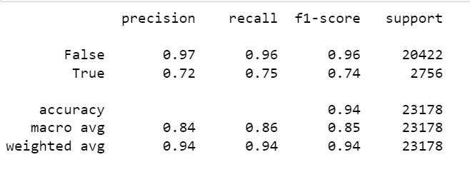
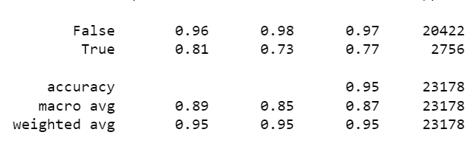
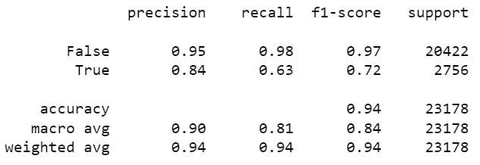
ML Methods + Metrics
No special optimizations in code
LinearSVC best before tuning
hyperparameters (learned from metrics)
MultinomialNB()
LinearSVC (top w/o hyperparameter tuning, bottom w/hyperparameter tuning-best final results metric)
RandomForestClassifier()

Slide 5
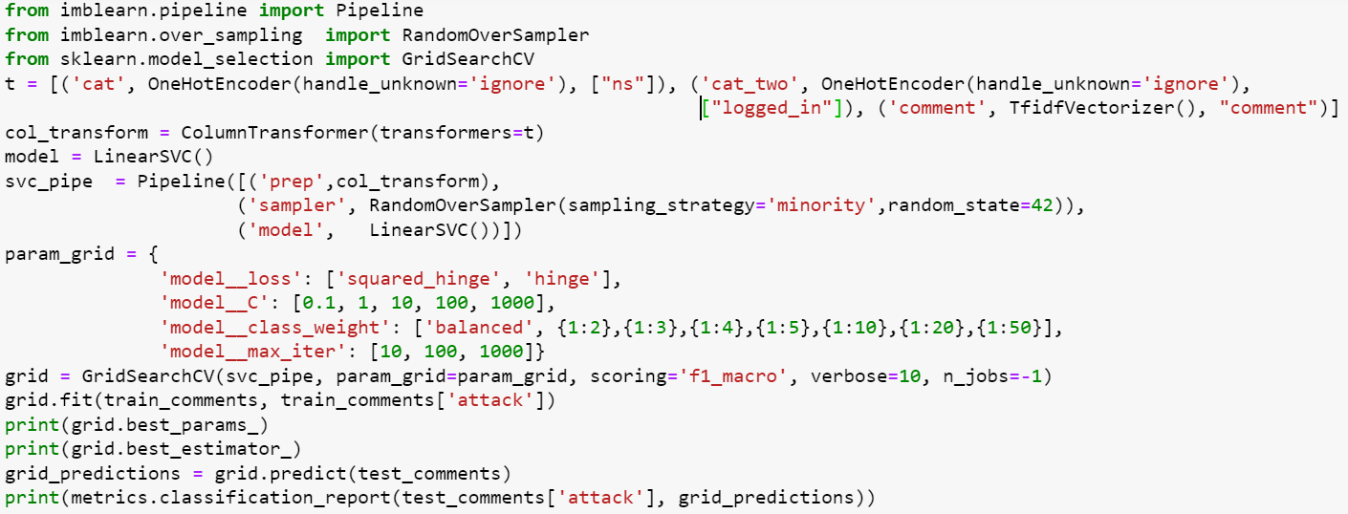
Summary
Tune hyperparameters C, loss, class_weight, max_iter
F1 score went up 2 percentage points as a result of my hyperparameter tuning
5 percentage point increase in f1 score, 7 percentage point increase in precision, 4 percentage point increase in recall compared to strawman
Cross validation was very useful to prevent overfitting/promote generalizability

